Slide 1

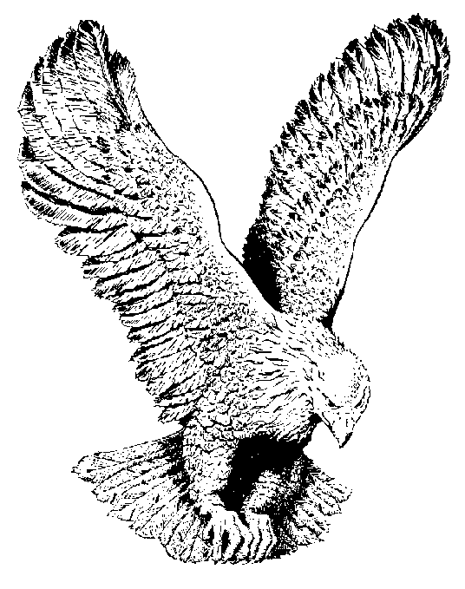
670 I SAW THE LORD
I saw the Lord, I saw the Lord.
He was high and lifted up
And His train filled the temple
He was high and lifted up
And His train filled the temple.
The angels cried “Holy”
The angels cried “Holy”
The angels cried “Holy unto the Lord.”

